Slide 1



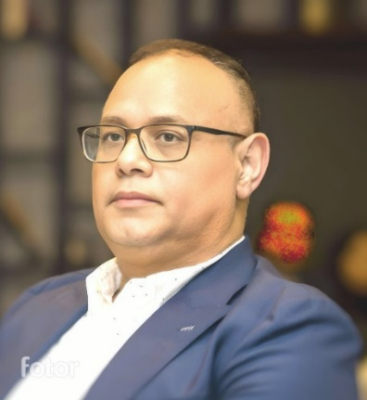

VOLUNTEERING
DR.ZAKRIA OSMAN
ABOUT ME
EDUCATION
PROFESSIONAL MEMBERSHIP
PAPERS PUBLISHED
Dr. Zakria Osman
PROFESSIONAL PROFILE
EUR ING FEANI, PhD, MSc, CEng MIET, CEng FCIBSE, CPEng MIEAust, IntPE(Aus.), NER, RPEng BPEQ, APEC Engineer, PMP® LEED AP B+C, FSDE,
Smart cities, sustainability, Carbon Emission & Digital Construction
PORTOFOLIO

Slide 2
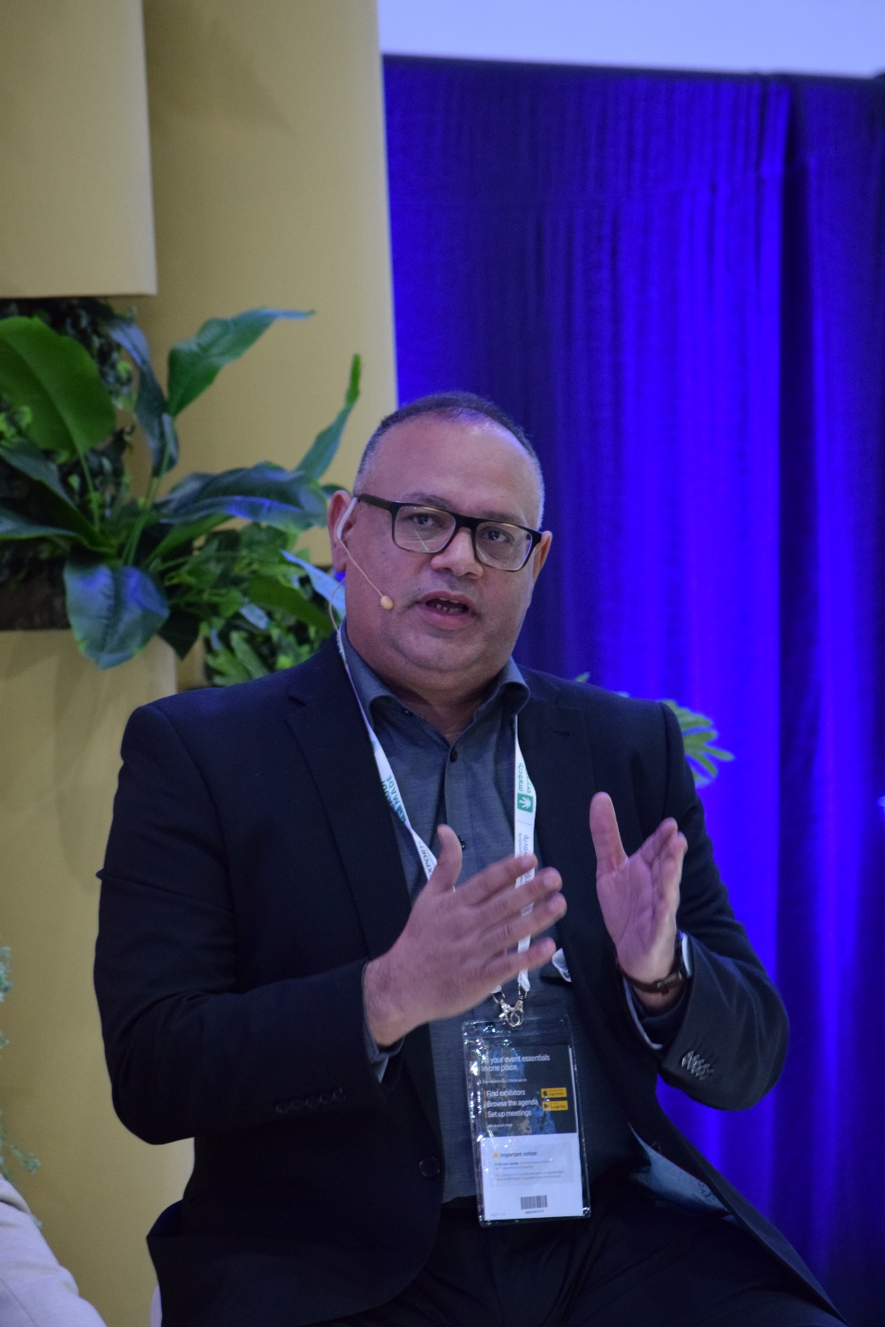
VOLUNTEERING
DR.ZAKRIA OSMAN
MY BIOGRAPHY
EDUCATION
PROFESSIONAL MEMBERSHIP
PAPERS PUBLISHED
is a highly accomplished mechanical engineer with profound expertise in cutting-edge research and development. Zakaria holds a Ph.D., MSc. and over 25 years of experience, he brings an unparalleled depth of knowledge and a passion for expanding the boundaries of engineering. Throughout his academic and professional career, Zakaria made significant contributions in the field of mechanical engineering. He conducted extensive research in specialized areas such as Digital Construction, Smart Cities, Digital Engineering, Pre-fabrication/Modular Construction, exploring novel concepts and methodologies to address complex engineering challenges.
Zakaria's research acumen is complemented with his strong technical skills and proficiency in advanced analytical tools. He is adapting in utilizing state-of-the-art simulation software and computational methods to model and analyze complex mechanical systems. His research findings have been presented in his work at prestigious conferences and symposiums.
Zakaria's ability to conceptualize and implement complex designs has been instrumental in the successful completion of numerous projects. He is highly proficient in using cutting-edge design and simulation software, enabling him to optimize designs for performance, reliability, and manufacturability.
As a passionate advocate for sustainable engineering practices, Zakaria is dedicated to developing environmentally conscious solutions that will improve our planet’s sustainability. He actively collaborates with organizations focused on green technologies and actively seeks opportunities to incorporate sustainability principles into his projects.
With a unique blend of research expertise, technical proficiency, and visionary leadership, Zakaria is poised to continue making significant contributions to the fields of engineering and construction. His unwavering commitment to advancing knowledge and driving innovation positions him as a sought-after expert and a catalyst for positive change in the industry
MY BIOGRAPHY
PORTOFOLIO

Slide 3
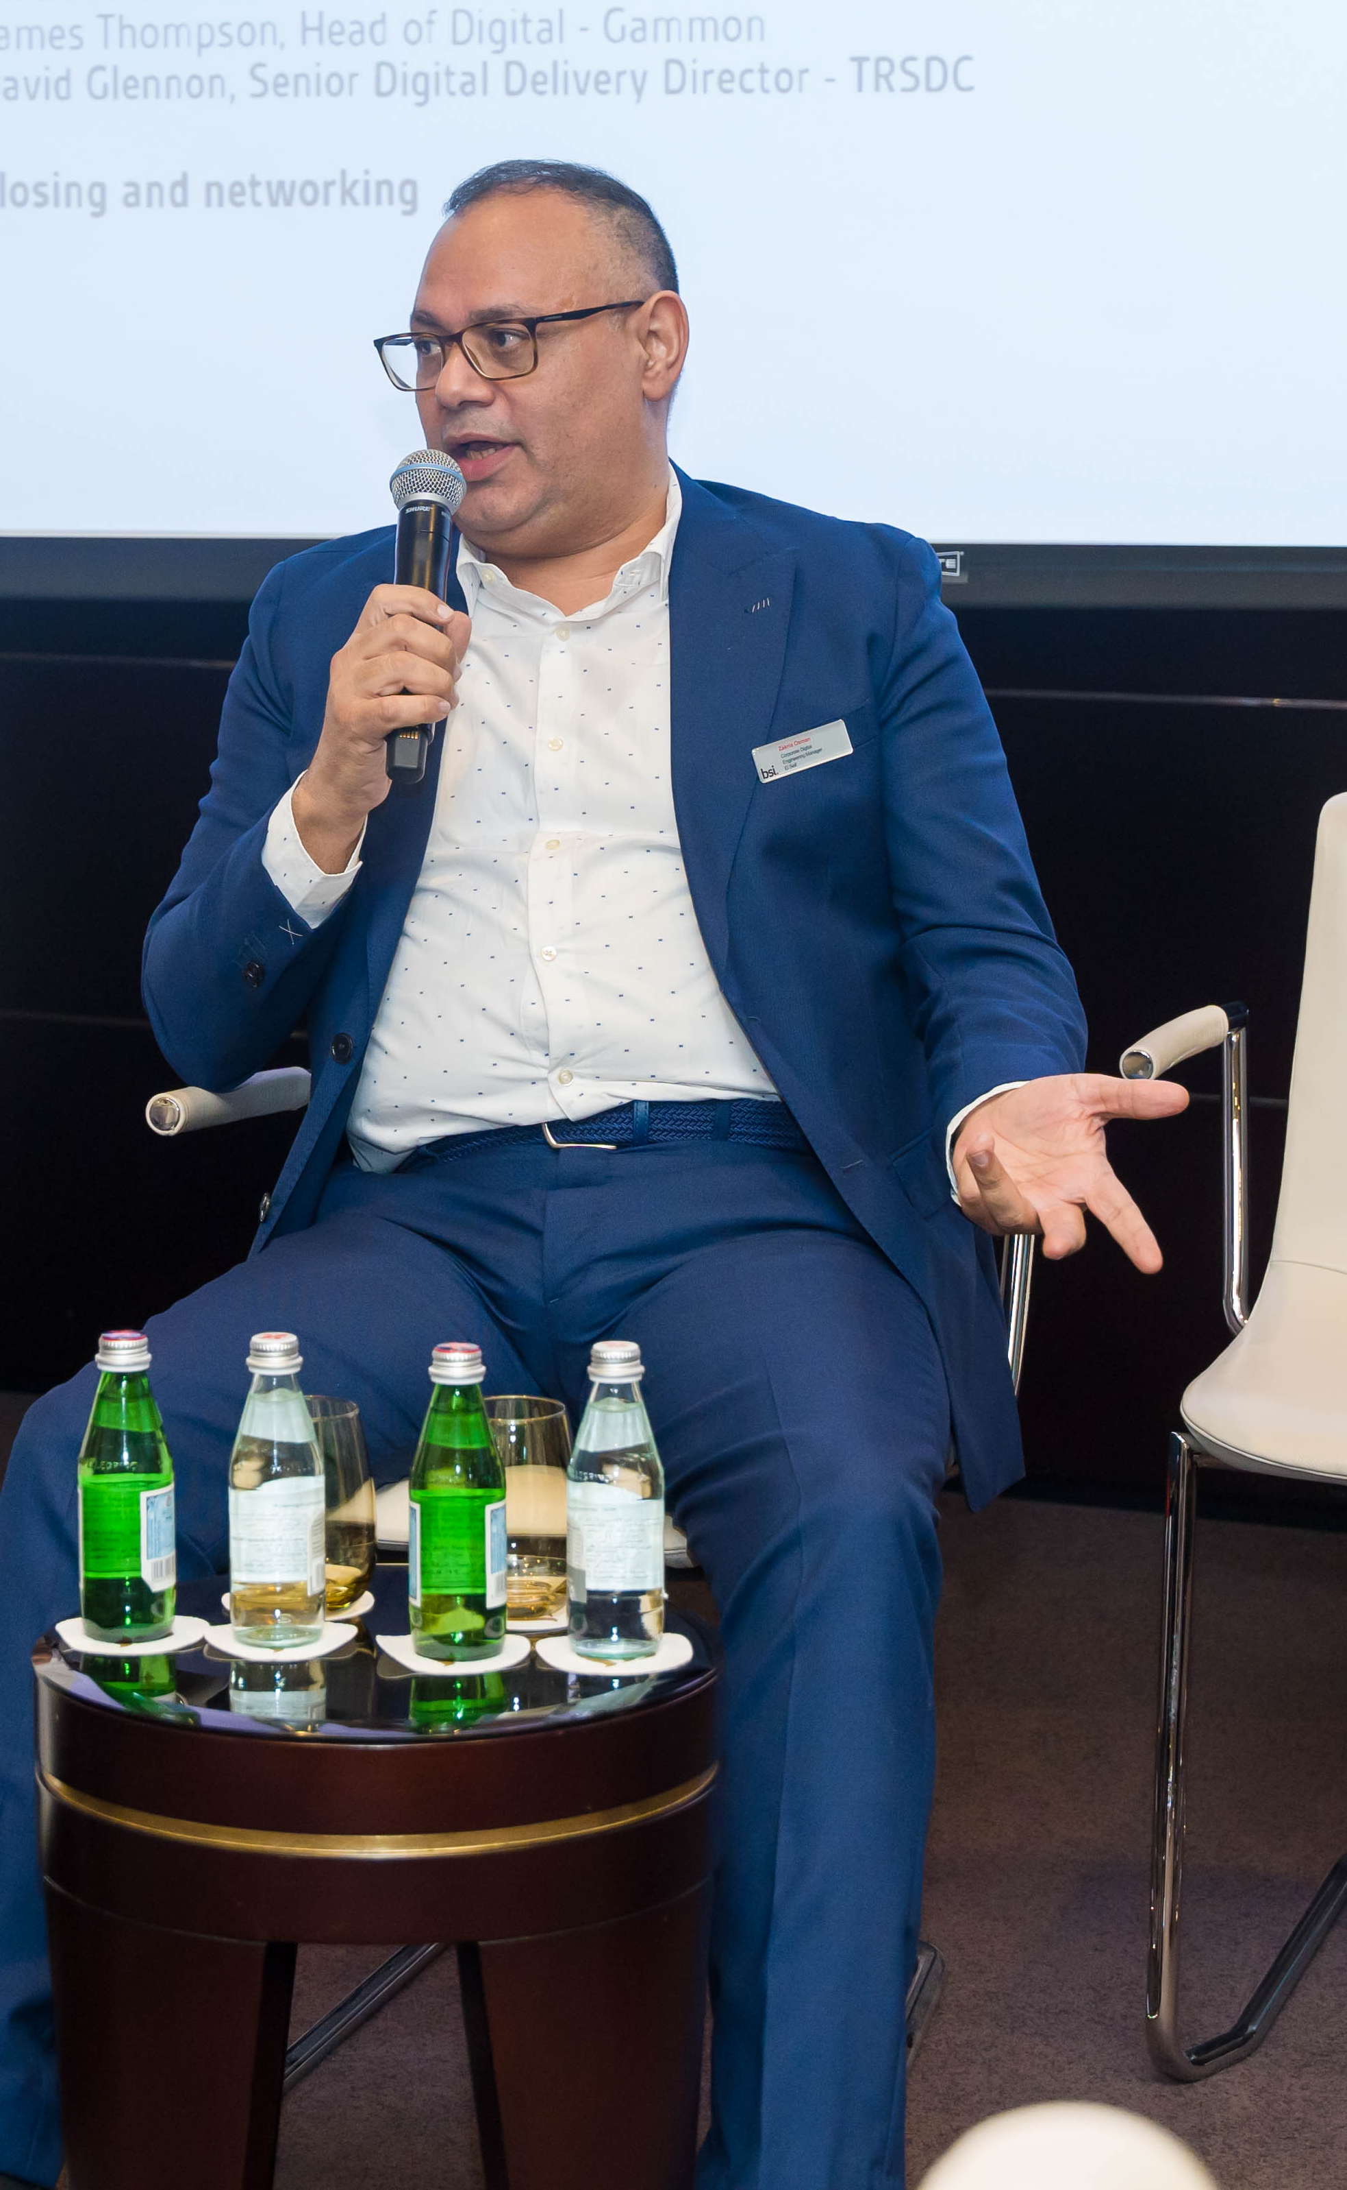
VOLUNTEERING
DR.ZAKRIA OSMAN
ABOUT ME
EDUCATION
PROFESSIONAL MEMBERSHIP
PAPERS PUBLISHED
EDUCATION
PhD in Sustainable Energy Management (School of Business)
Master of Science in Engineering (School of Engineering and Physical sciences) Heriot Watt University –UK
Master of Science in Environmental Management (School of sciences)
University of Nicaragua.
Master of Science in Piping design and Engineering University of Azteca Mexico
Post Graduate Engineering (piping design & Engineering) Maharashtra Institute of Technology, Pune (School of Engineering)
Engineering degree Mechanical Engineering.
PORTOFOLIO

Slide 4
VOLUNTEERING
DR.ZAKRIA OSMAN
ABOUT ME
EDUCATION
PROFESSIONAL MEMBERSHIP
PAPERS PUBLISHED
PROFESSIONAL MEMBERSHIP:
Asia Pacific Economic Cooperation (APEC) Engineer within Mechanical Engineering, Building Services (APEC Engineer).
Registered Professional Engineers of Queensland Australia RPEng
The Board of Professional Engineers of Queensland Australia BPEQ
A credential LEED AP Building Design + Construction (LEED AP BD+C)
(U.S. Green Building Council)
Project Management Professional Certified (PMP®) (Project Management Institute USA)
Project Management Institute (PMI) Membership No 2808620
The Institution of Engineering Technology (MIET) Membership No 1100297883
Fellow of Chartered Institution of Building Services Engineers (FIBSE) Reg. No. 063559
Engineers Australia Membership Professional Category (MIEAust) EA ID: 8389460
Certified professional chief Engineer from Gov. of Kazakhstan for Engineering work (certification No 0021)
Certified professional chief Engineer Gov. of Kazakhstan for Project work
(certification No 0022)
Certified European Engineer designation (EUR ING) awarded by the European Federation of National Page 1 of 3 Engineering Associations(FEANI)
Chartered Engineer CEng IET, Engineering Council UK Reg. No. 690480
Chartered Engineer CEng Chartered Institution of Building Services Engineers (CIBSE) Engineering Council UK.
Member of society of Digital Engineering-UK FSDE
Chartered Professional Engineer CPEng within Mechanical Engineering, Building Services, and Project Management (CPEng) (Engineers Australia).
International Professional Engineer IntPE (Aus.) International Engineering Association (IEA) within Mechanical Engineering, Building Services IntPE (Aus.).
PORTOFOLIO

Slide 5
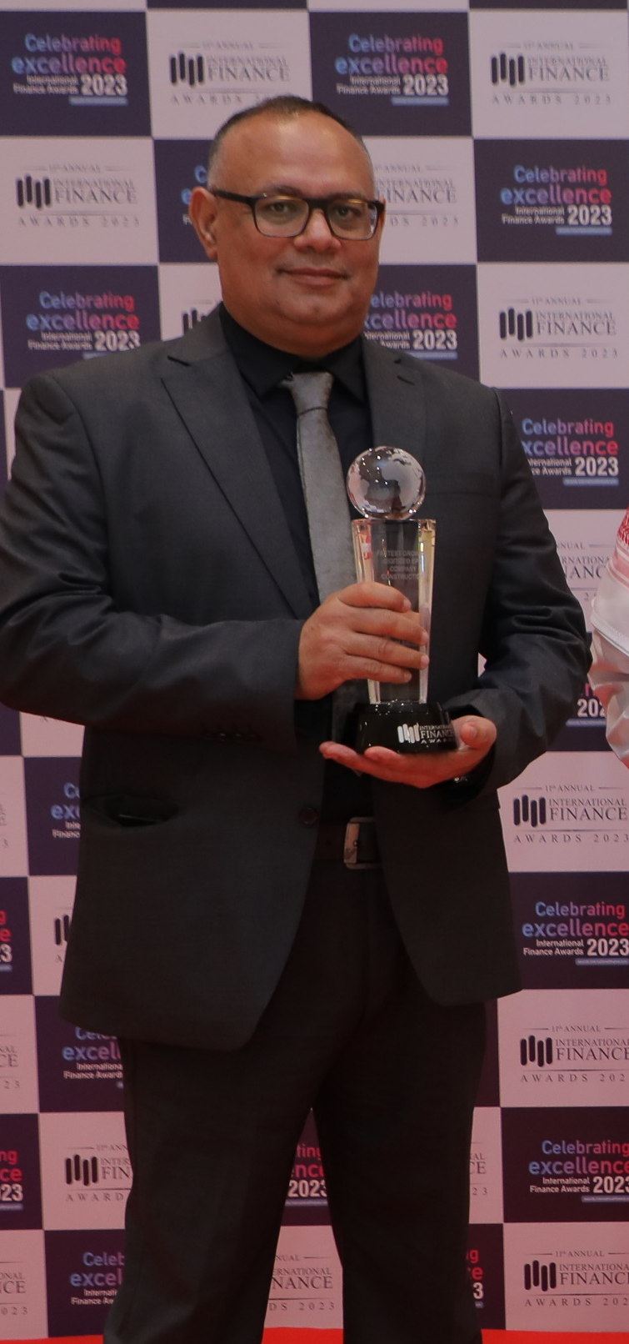
PAPERS PUBLISHED
DR.ZAKRIA OSMAN
ABOUT ME
EDUCATION
PROFESSIONAL MEMBERSHIP
VOLUNTEERING
PROFESSIONAL SERVICES, PAPERS PUBLISHED:
1- BIOGAS / PV HYBRID STANDALONE SYSTEM FOR LABOUR CAMP ELECTRIFICATION
Description: Hybrid, Solar PV, Biogas, Labour camp, UAE, power supply, rural
Link:https://1drv.ms/b/s!AnRbVy4z7r1fjrZodp6zvj7d2xryFg?e=QWbWgm
2- An analytical study of environmental issues in the sustainable renewable energy development in the UAE
Date: 17 Apr 2017
Description: 4D INTERNATIONAL RESEARCH JOURNAL(IMPACT FACTOR:-3.256)
Link:http://4dinternationaljournal.com/wp-content/uploads/2018/08/Thesis-December-2017-Fin.Copy_.pdf
Notes:
An analytical study of environmental issues in the sustainable renewable energy development in the UAE
3- Built-today-using-tomorrow-technology-Smart-MEP
Date: 17 Apr 2019
Description: Autodesk University
Link:https://www.autodesk.com/autodesk-university/class/Built-today-using-tomorrow-technology-Smart-MEP-C
PORTOFOLIO

Slide 6
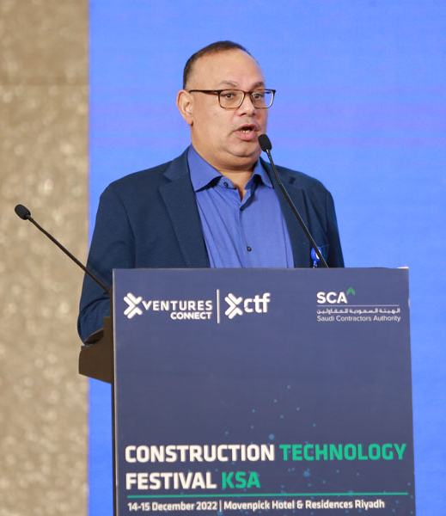
VOLUNTEERING
DR.ZAKRIA OSMAN
ABOUT ME
EDUCATION
PROFESSIONAL MEMBERSHIP
PAPERS PUBLISHED
VOLUNTEERING
1- Continuing professional development (CPD) Sub-Panel Assessor
Chartered Institution of Building Services Engineers – UK (CIBSE)
2- End Point Assessment (EPA)Chartered Institution of Building Services
Engineers – UK (CIBSE)
3- Mentor Chartered Institution of Building Services Engineers – UK (CIBSE)
4- One of the Founder of Board of the professional Engineers of Kazakhstan
(BOPE)

